Slide 1
Work on Multiple Table
Join and Set Operation

Slide 2
JOINING

Slide 3

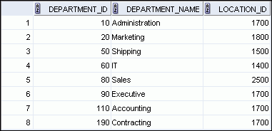

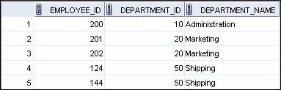

Obtaining Data from Multiple Tables
EMPLOYEES
DEPARTMENTS
…
…
Notes:
Obtaining Data from Multiple Tables
Sometimes you need to use data from more than one table. In the example in the slide, the report displays data from two separate tables:
Employee IDs exist in the EMPLOYEES table.
Department IDs exist in both the EMPLOYEES and DEPARTMENTS tables.
Department names exist in the DEPARTMENTS table.
To produce the report, you need to link the EMPLOYEES and DEPARTMENTS tables, and access data from both of them.

Slide 4
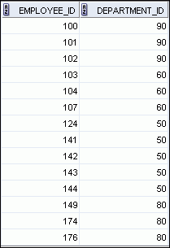
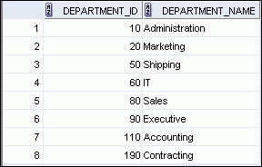
Joining Column Names
Join adalah menggabungkan 2 tabel menggunakan kolom penghubung yang sering disebut sebagai key
Key adalah salah satu kolom di masing-masing tabel yang akan di-join yang memiliki format sama
EMPLOYEES
DEPARTMENTS
Primary key
…
Foreign key
Notes:
Joining Column Names
To determine an employee’s department name, you compare the value in the DEPARTMENT_ID column in the EMPLOYEES table with the DEPARTMENT_ID values in the DEPARTMENTS table. The relationship between the EMPLOYEES and DEPARTMENTS tables is an equijoin; that is, values in the DEPARTMENT_ID column in both the tables must be equal. Frequently, this type of join involves primary and foreign key complements.
Note: Equijoins are also called simple joins or inner joins.

Slide 5
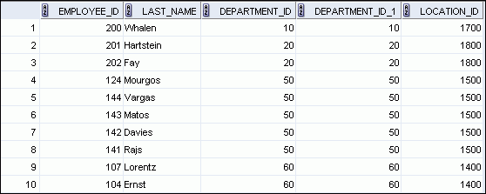
Retrieving Records with the ON Clause
SELECT e.employee_id, e.last_name, e.department_id,
d.department_id, d.location_id
FROM employees e JOIN departments d
ON (e.department_id = d.department_id);
…
Notes:
Retrieving Records with the ON Clause
In this example, the DEPARTMENT_ID columns in the EMPLOYEES and DEPARTMENTS table are joined using the ON clause. Wherever a department ID in the EMPLOYEES table equals a department ID in the DEPARTMENTS table, the row is returned. The table alias is necessary to qualify the matching column_names.
You can also use the ON clause to join columns that have different names. The parenthesis around the joined columns as in the slide example, (e.department_id = d.department_id) is optional. So, even ON e.department_id = d.department_id will work.
Note: SQL Developer suffixes a ‘_1’ to differentiate between the two department_ids.

Slide 6
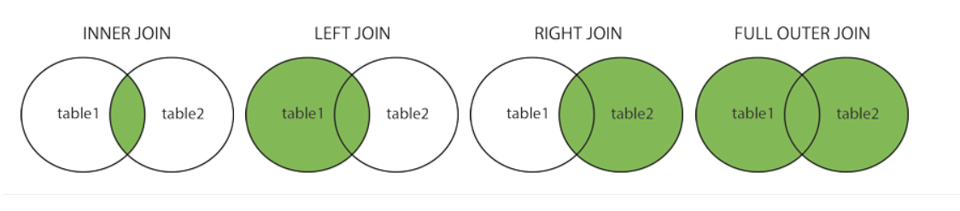
JOIN
Join adalah menggabungkan 2 tabel menggunakan kolom penghubung yang sering disebut sebagai key
Key adalah salah satu kolom di masing-masing tabel yang akan di-join yang memiliki format sama
Terdapat empat kemungkinan join sebagai berikut:
returning only matched rows
inner join + unmatched rows from the left/right
returning all
Contoh:
SELECT *
FROM table1 LEFT JOIN table2
ON table2.CustomerID=table1.CustomerID;
Notes:
INNER Versus OUTER Joins
Joining tables with the NATURAL JOIN, USING, or ON clauses results in an inner join. Any unmatched rows are not displayed in the output. To return the unmatched rows, you can use an outer join. An outer join returns all rows that satisfy the join condition and also returns some or all of those rows from one table for which no rows from the other table satisfy the join condition.
There are three types of outer joins:
LEFT OUTER
RIGHT OUTER
FULL OUTER

Slide 7
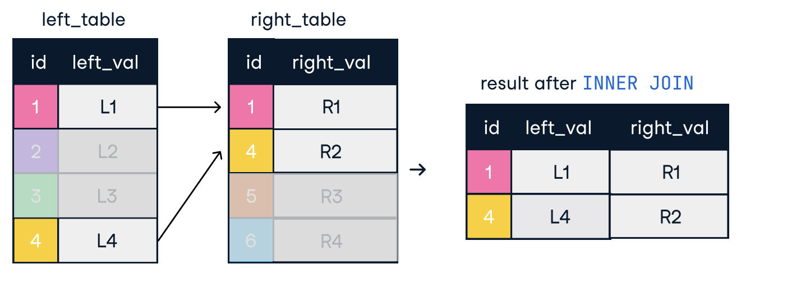
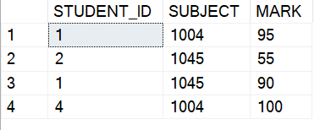
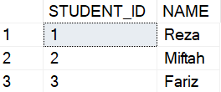
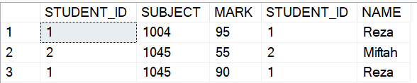
Inner Join /Join
Inner join antara dua tabel hanya mengambil data-data yang kolom penghubungnya (seperti key), menemukan kecocokan di kedua tabel.
SELECT *
FROM dbo.NILAI nil
INNER JOIN dbo.STUDENT std
ON nil.STUDENT_ID = std.STUDENT_ID
dbo.NILAI
dbo.STUDENT
hasil

Slide 8
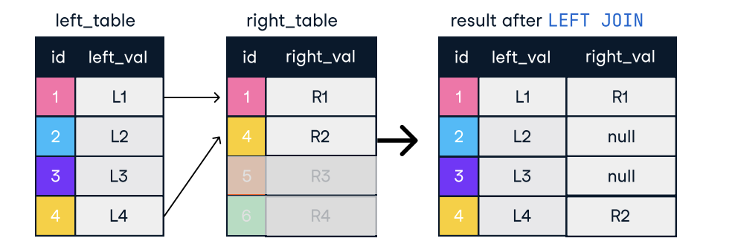
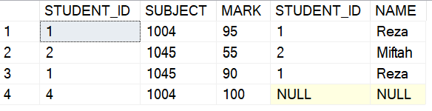
Left Join
Left join antara dua tabel: mengambil seluruh data dari tabel kiri (di FROM) dan mengembalikan nilai Null dari tabel kanan pada data yang key-nya tidak cocok.
SELECT *
FROM dbo.NILAI nil
LEFT JOIN dbo.STUDENT std
ON nil.STUDENT_ID = std.STUDENT_ID
dbo.NILAI
dbo.STUDENT
hasil

Slide 9
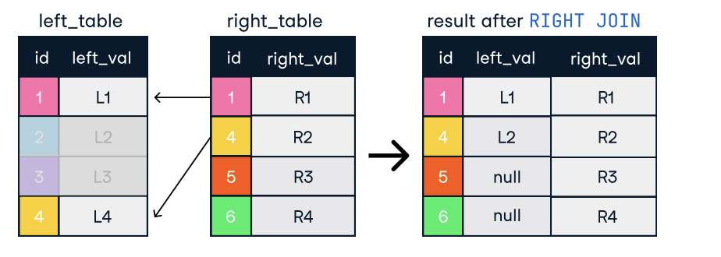
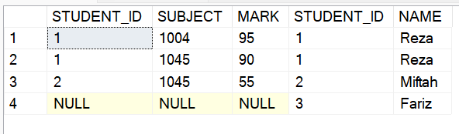
Right Join
Right join antara dua tabel: sama seperti left join tapi yang diambil semua sebelah kanan
SELECT *
FROM dbo.NILAI nil
RIGHT JOIN dbo.STUDENT std
ON nil.STUDENT_ID = std.STUDENT_ID
dbo.NILAI
dbo.STUDENT
hasil

Slide 10
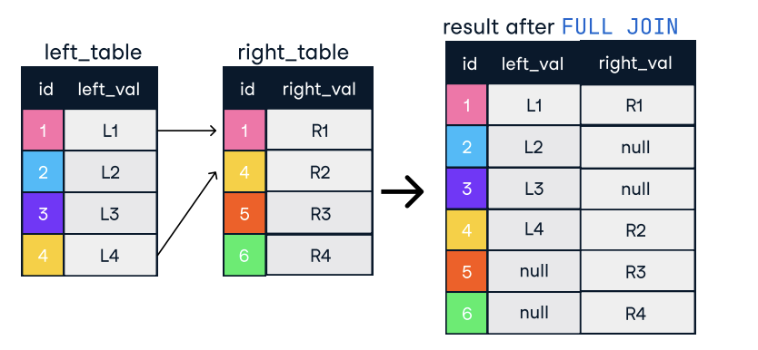
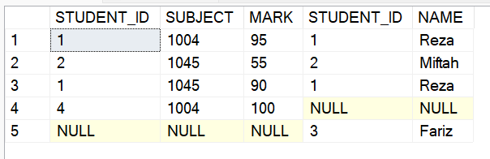
Full Join
Kombinasi right dan left join. Tabel kanan dan kiri diambil semua, ketika key tidak match akan ditampilkan Null.
SELECT *
FROM dbo.NILAI nil
FULL JOIN dbo.STUDENT std
ON nil.STUDENT_ID = std.STUDENT_ID
dbo.NILAI
dbo.STUDENT
hasil

Slide 11
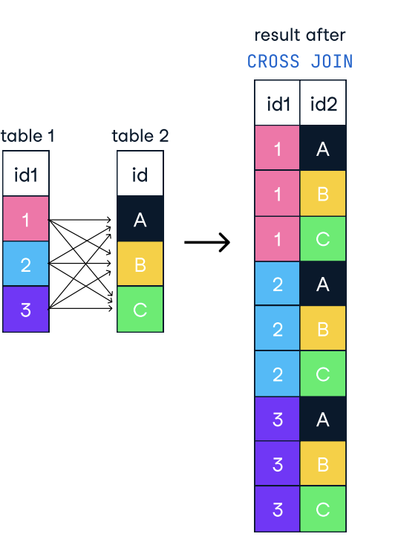
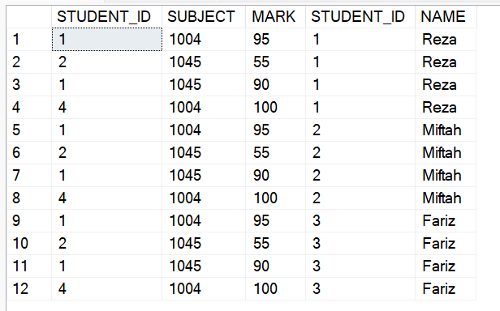
CROSS JOIN
Membuat kombinasi seluruh data
SELECT *
FROM dbo.NILAI
CROSS JOIN dbo.STUDENT
atau
SELECT *
FROM dbo.NILAI, dbo.STUDENT
dbo.NILAI
dbo.STUDENT
hasil

Slide 12
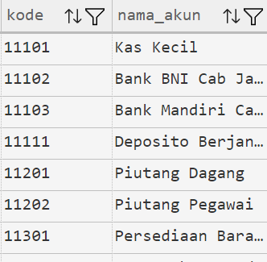
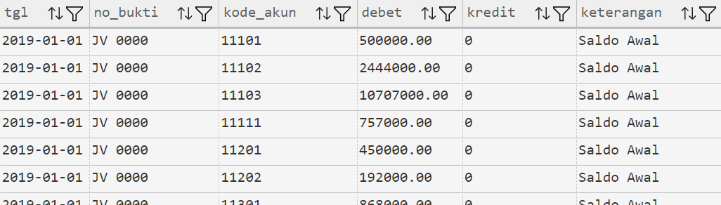
HANDS-ON DATA JURNAL
akun.bagan_akun
Untuk membuat Neraca Saldo dengan kolom:
Kode akun
Nama akun
Debet
Kredit
JOIN seperti apa yang perlu digunakan?
Kalau menggunakan LEFT/RIGHT JOIN, apa tabel yang di kiri/kanan?
akun.jurnal2019

Slide 13
HANDS-ON DATA JURNAL
Buat Neraca Saldo Semester I 2019 dengan kolom:
Kode akun
Nama akun
Debet
Kredit

Slide 14


Buat Query?
Employee
Project
“ untuk tiap employee, berapa total jumlah biaya project atas semua project yang ditugaskan kepada mereka?”
SELECT e.name, sum(cost) as total
FROM employee e
RIGHT JOIN project p ON e.id = p.empid
GROUP BY e.name;
B. SELECT e.name, ISNULL(sum(cost),0) as total
FROM employee e
LEFT JOIN project p ON e.id = p.empid
GROUP BY e.name;
C. SELECT e.name, sum(cost) as total
FROM employee e
FULL JOIN project p ON e.id = p.empid
GROUP BY e.name;

Slide 15
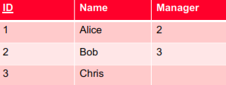
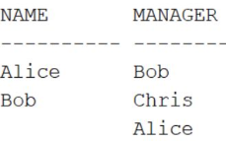
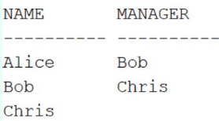
Apa hasil Query ini?
Employee table:
SELECT e1.NAME as name,
e2.name as manager
FROM employee e1
RIGHT JOIN employee e2
ON e1.manager = e2.id;
A
B

Slide 16
Buat Query
“Tampilkan employee yang menerima salary tidak sesuai dengan ketentuan salary?”
Ketentuan salary di table Employees
Pembayaran gaji di table Payroll
Tampilkan Employee ID, First Name, Salary Real, Salary sesuai ketentuan, tahun, bulan

Slide 17
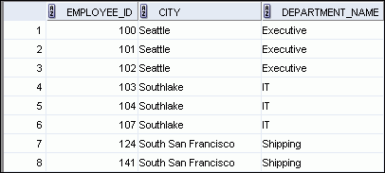
Creating Three-Way Joins with the ON Clause
SELECT employee_id, city, department_name
FROM employees e
JOIN departments d
ON d.department_id = e.department_id
JOIN locations l
ON d.location_id = l.location_id;
…
Notes:
Creating Three-Way Joins with the ON Clause
A three-way join is a join of three tables. In SQL:1999–compliant syntax, joins are performed from left to right. So, the first join to be performed is EMPLOYEES JOIN DEPARTMENTS. The first join condition can reference columns in EMPLOYEES and DEPARTMENTS but cannot reference columns in LOCATIONS. The second join condition can reference columns from all three tables.
Note: The code example in the slide can also be accomplished with the USING clause:
SELECT e.employee_id, l.city, d.department_name
FROM employees e
JOIN departments d
USING (department_id)
JOIN locations l
USING (location_id)

Slide 18
SET OPERATION

Slide 19
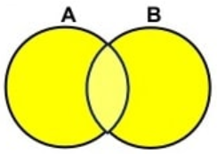
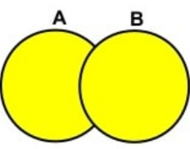
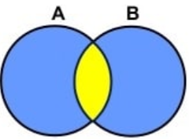
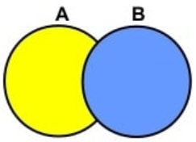
Relational Set Operations
UNION ALL
UNION
INTERSECT
EXCEPT
Semua row digabungkan. Walau ada row duplikat
Semua row digabungkan dan row yang duplikat di hilangkan (disisakan satu). Distinct dari UNION ALL
Ditampilkan row duplikat (ada di kedua sisi), namun hanya distinct row yang disisakan
Ditampilkan row dari sisi yang tidak ada di kanan
UNION COMPATIBLE
Same number of attributes
Similar datatypes
Notes:
Requirements for UNION:
Every SELECT statement within UNION must have the same number of columns
The columns must also have similar data types
The columns in every SELECT statement must also be in the same order

Slide 20
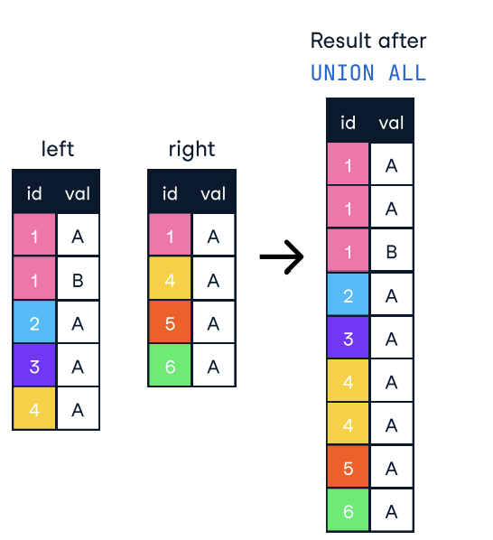
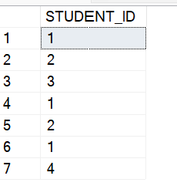
UNION ALL
Semua row digabungkan. Walau ada row duplikat
SELECT STUDENT_ID
FROM dbo.STUDENT
UNION ALL
SELECT STUDENT_ID
FROM dbo.NILAI
dbo.NILAI
dbo.STUDENT
hasil

Slide 21
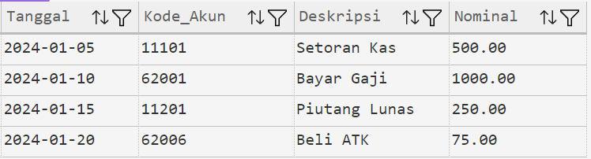
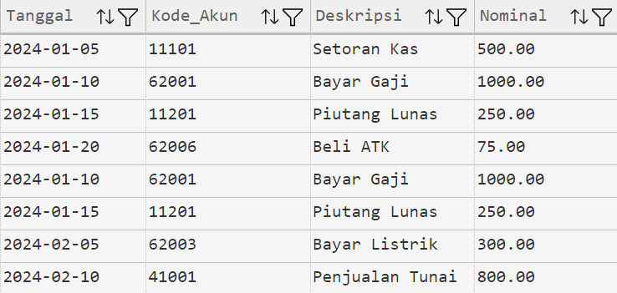
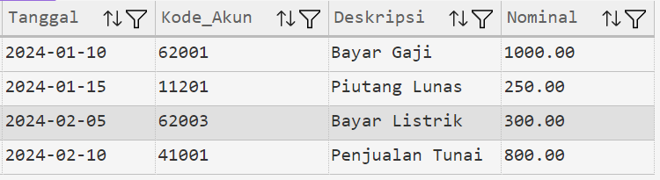
UNION ALL
Menggabungkan hasil dari kedua tabel dan menyertakan semua baris duplikat.
Jurnal_Januari
SELECT * FROM akun.Jurnal_Januari
UNION ALL
SELECT * FROM akun.Jurnal_Februari;
Jurnal_Februari

Slide 22
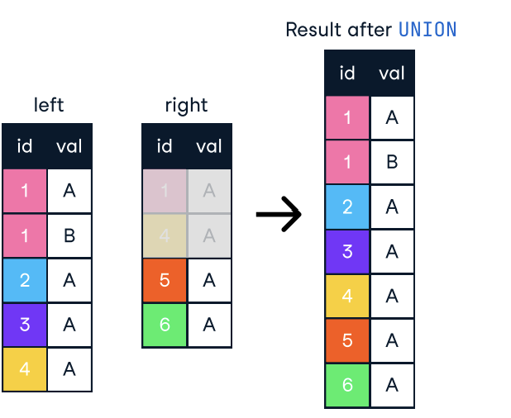
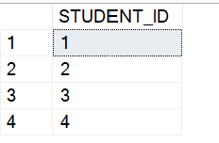
UNION
Semua row digabungkan yang duplikat tidak ikut
SELECT STUDENT_ID
FROM dbo.STUDENT
UNION
SELECT STUDENT_ID
FROM dbo.NILAI
dbo.NILAI
dbo.STUDENT
hasil

Slide 23
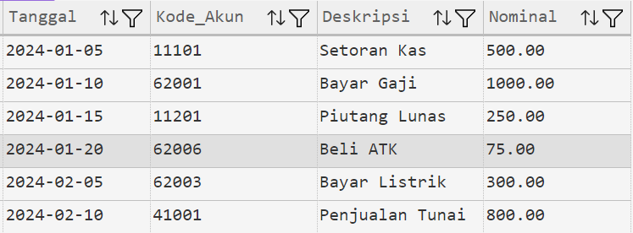
UNION
Menggabungkan hasil dari kedua tabel dan menghapus baris duplikat (identik).
Jurnal_Januari
SELECT * FROM akun.Jurnal_Januari
UNION
SELECT * FROM akun.Jurnal_Februari;
Jurnal_Februari

Slide 24
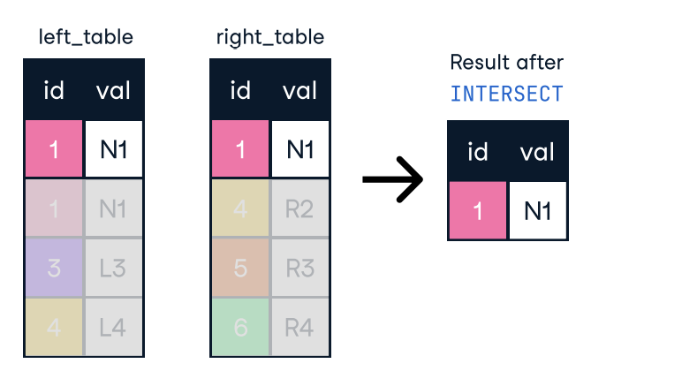
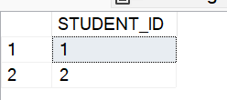
INTERSECT
Ditampilkan row duplikat (ada di kedua sisi), namun hanya distinct row yang disisakan
SELECT STUDENT_ID
FROM dbo.STUDENT
INTERSECT
SELECT STUDENT_ID
FROM dbo.NILAI
dbo.NILAI
dbo.STUDENT
hasil

Slide 25
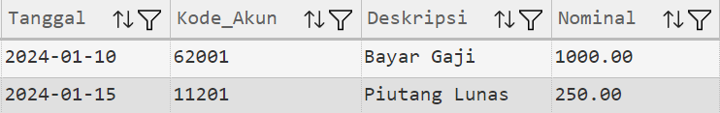
INTERSECT
Hanya menampilkan baris yang identik (ada) di kedua tabel.
Jurnal_Januari
SELECT * FROM akun.Jurnal_Januari
INTERSECT
SELECT * FROM akun.Jurnal_Februari;
Jurnal_Februari

Slide 26
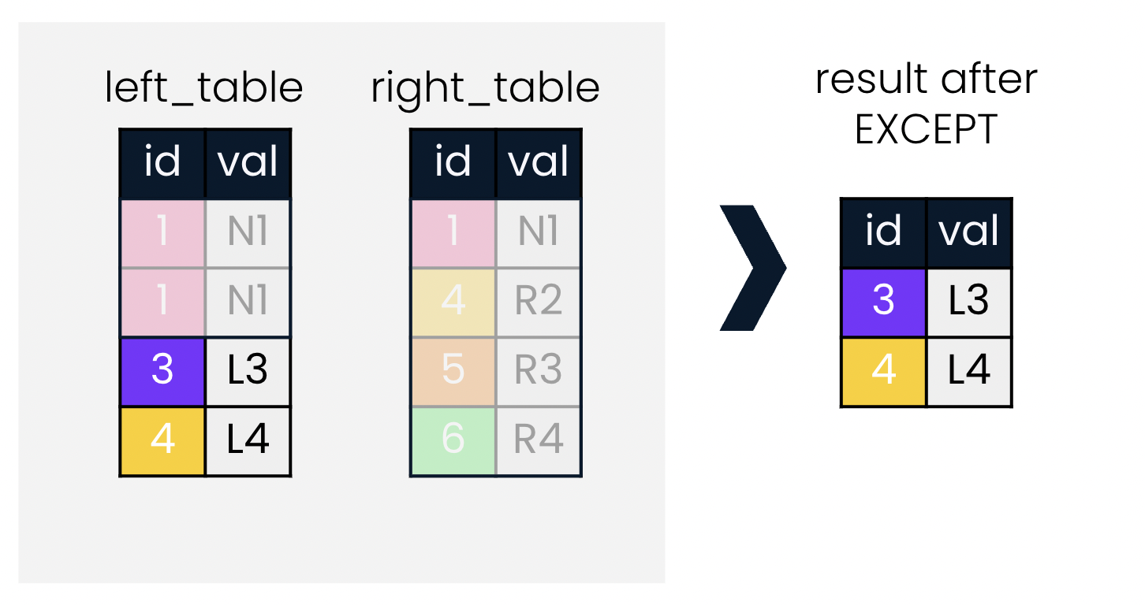

EXCEPT
Ditampilkan row dari sisi yang tidak ada di kanan.
SELECT STUDENT_ID
FROM dbo.STUDENT
EXCEPT
SELECT STUDENT_ID
FROM dbo.NILAI
dbo.NILAI
dbo.STUDENT
hasil

Slide 27
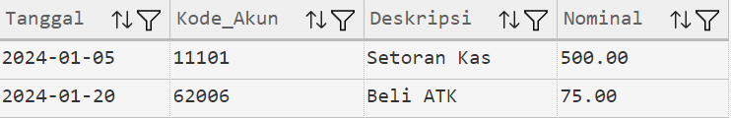
EXCEPT
Menampilkan baris dari tabel pertama (Jurnal_Januari) yang tidak ada di tabel kedua (Jurnal_Februari).
Jurnal_Januari
SELECT * FROM akun.Jurnal_Januari
EXCEPT
SELECT * FROM akun.Jurnal_Februari;
Jurnal_Februari

Slide 28
Contoh di data HR

Slide 29

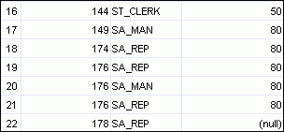
Using the UNION ALL Operator
Display the current and previous departments of all employees.
SELECT employee_id, job_id, department_id
FROM employees
UNION ALL
SELECT employee_id, job_id, department_id
FROM job_history
ORDER BY employee_id;
…
…
Notes:
Using the UNION ALL Operator
In the example, 30 rows are selected. The combination of the two tables totals to 30 rows. The UNION ALL operator does not eliminate duplicate rows. UNION returns all distinct rows selected by either query. UNION ALL returns all rows selected by either query, including all duplicates. Consider the query in the slide, now written with the UNION clause:
SELECT employee_id, job_id,department_id
FROM employees
UNION
SELECT employee_id, job_id,department_id
FROM job_history
ORDER BY employee_id;
The preceding query returns 29 rows. This is because it eliminates the following row (because it is a duplicate):

Slide 30


Using the UNION Operator
Display the current and previous job details of all employees. Display each employee only once.
SELECT employee_id, job_id
FROM employees
UNION
SELECT employee_id, job_id
FROM job_history;
…
…
Notes:
Using the UNION Operator
The UNION operator eliminates any duplicate records. If records that occur in both the EMPLOYEES and the JOB_HISTORY tables are identical, the records are displayed only once. Observe in the output shown in the slide that the record for the employee with the EMPLOYEE_ID 200 appears twice because the JOB_ID is different in each row.
Consider the following example:
SELECT employee_id, job_id, department_id
FROM employees
UNION
SELECT employee_id, job_id, department_id
FROM job_history;
…
…

Slide 31

Using the INTERSECT Operator
Display employees who have a same job from the job history table
SELECT employee_id, job_id
FROM employees
INTERSECT
SELECT employee_id, job_id
FROM job_history;
Notes:
Using the UNION Operator
The UNION operator eliminates any duplicate records. If records that occur in both the EMPLOYEES and the JOB_HISTORY tables are identical, the records are displayed only once. Observe in the output shown in the slide that the record for the employee with the EMPLOYEE_ID 200 appears twice because the JOB_ID is different in each row.
Consider the following example:
SELECT employee_id, job_id, department_id
FROM employees
UNION
SELECT employee_id, job_id, department_id
FROM job_history;
…
…

Slide 32
Using the EXCEPT Operator
SELECT employee_id, job_id
FROM employees
EXCEPT
SELECT employee_id, job_id
FROM job_history;
Dua row yang sebelumnya menjadi hasil INTERCEPT hilang dari tampilan result

Slide 33
Buat Query
Berapakah jumlah employee yang bekerja di US namun salary yang diterima lebih rendah dari pada jumlah rata-rata salary employee yang berkedudukan di luar US
Hint: data Salary di Table Employees, data negara di table location

